Slide 1
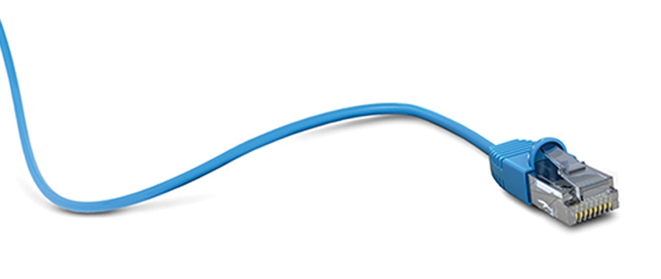
ISONAS Overview
Revolutionizing Access Control
With One Simple Solution

Slide 2
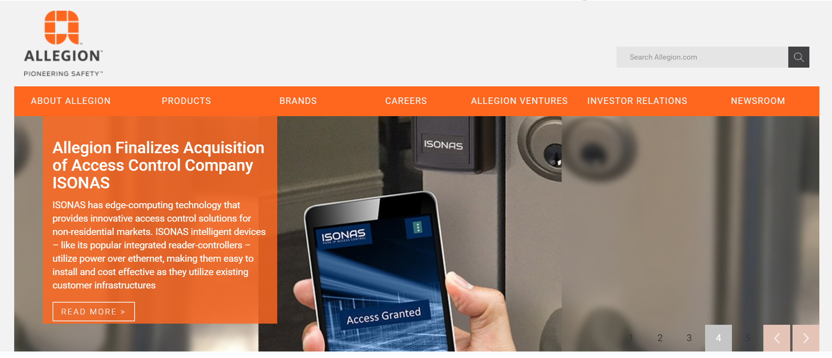
Allegion Acquires ISONAS July 2018

Slide 3



Premier Family of Industry Leading Brands

Slide 4

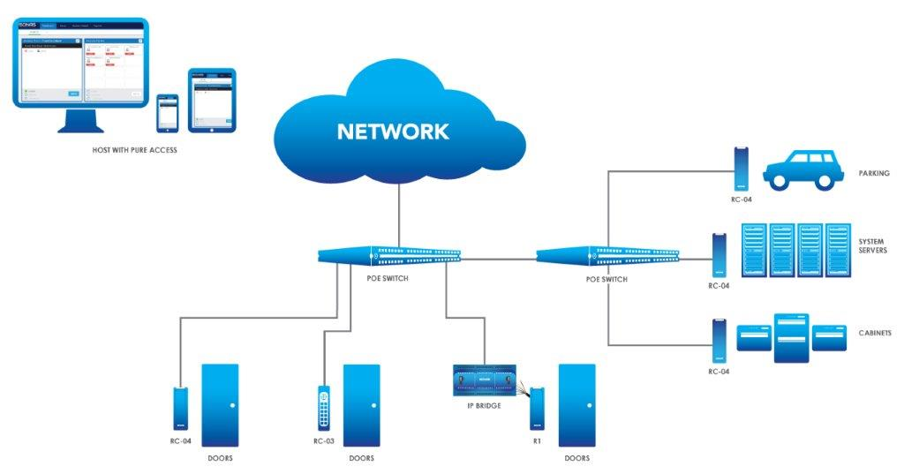

ISONAS Overview
Positioning

Slide 5
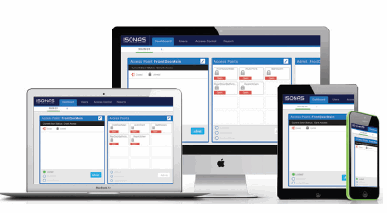
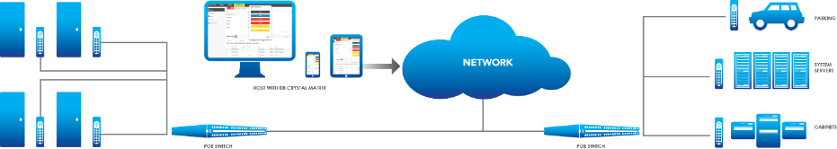
Ethos
Access Control belongs on the network.
Access control natively should have the ability to be managed from anywhere across unlimited numbers of facilities

Slide 6
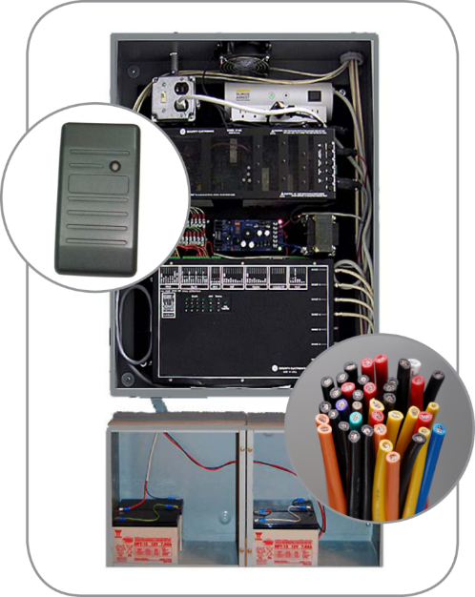
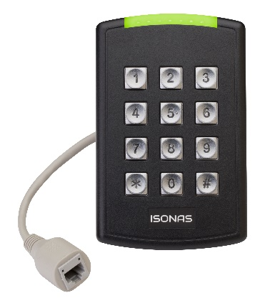
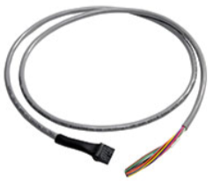
ISONAS is Simpler, Easier, Faster to Install
ISONAS Eliminates:
Electrician 120VAC
Main Panel
Door Controllers
Power Supply
1/2 Wire Terminations
All in One Reader Controller
Panel Access Control

Slide 7
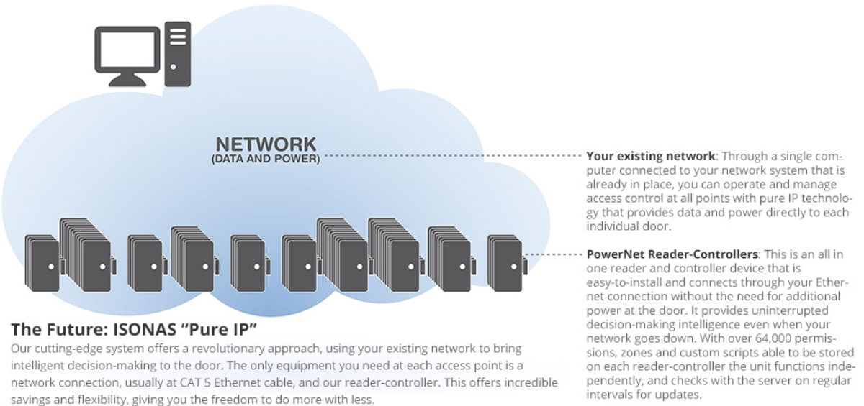
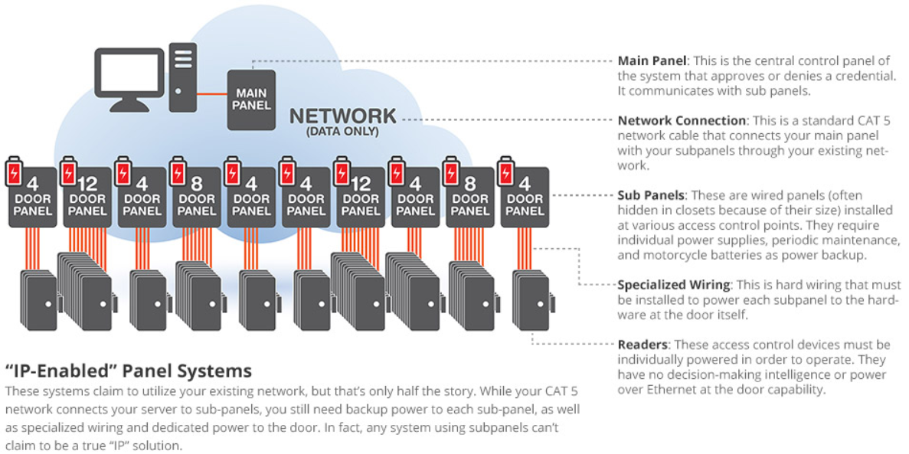
Why ISONAS?
We’re changing the game in access control.
Unlike traditional panel-based or IP-panel systems, ISONAS delivers the one proven access control solution that offers network-based, “Pure IP” to the door technology.
ISONAS eliminates the need for cumbersome control panels at each and every access point, complex wiring and power supplies that are costly, and regular maintenance across physical locations.
Innovative IP/POE reader-controllers provides a simpler and smarter alternative leveraging the IT Network.
Our innovative technology enables you to manage multiple locations in real-time through your existing network, lower your total cost of ownership, and experience the flexibility to go places your organization never imagined.
Dealer Advantage
Lower labor content for competitive bidding
Easier to install, commission & maintain
Support Recurring Monthly Revenue models

Slide 8


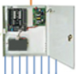
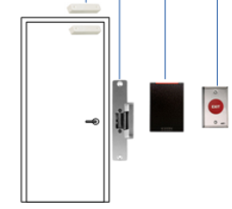
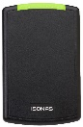
ISONAS is Simple

Slide 9
ISONAS is Access Control for Today….and the Future
Patented IP Hardware
ISONAS is the creator of Pure IP Access Control Hardware. Starting in 1999, our business has revolutionized the access control industry with IP Reader-Controllers that are superior to install, cost less than panel systems, and utilize todays networking technology.
Access Control Takeovers
Customers that have access control, want more access control and wish to be freed from their proprietary access control manufacturers. Utilizing our cost effective and scalable IP Bridge hardware product, customers can free themselves from proprietary manufactures and liberate themselves with IP Access Control while utilizing nearly all of their existing infrastructure.
Cloud Software
On Premise Software
ISONAS Pure Access Software is the premier product in the industry in usability and its cloud application architecture. Pure Access is optimal for geographically dispersed sites, in the educational, retail, municipal, corporate, and SMB markets.
Cybersecurity
Physical security products should inherently be cybersecure. ISONAS prides itself on leading the industry on providing robust cybersecure IP hardware and software solutions. Our business regularly employs 3rd party tests to ensure that ISONAS products are kept to the latest in security patches, therefore minimizing threats.
Open Platform
ISONAS has both an API for 3rd party software integrations and a SDK for integration of our patented Pure IP hardware. We fully embrace the open platform and strongly feel that customers need to select the best of breed product for their access control applications. ISONAS leads the industry on growing the open platform in access control.

Slide 10
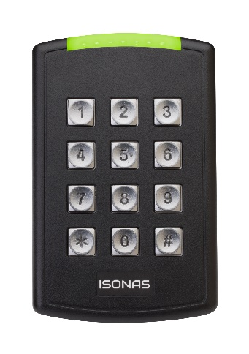
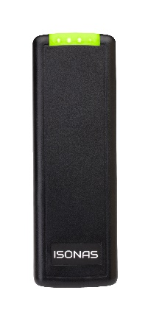
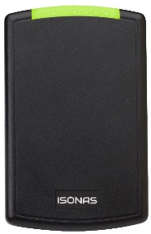
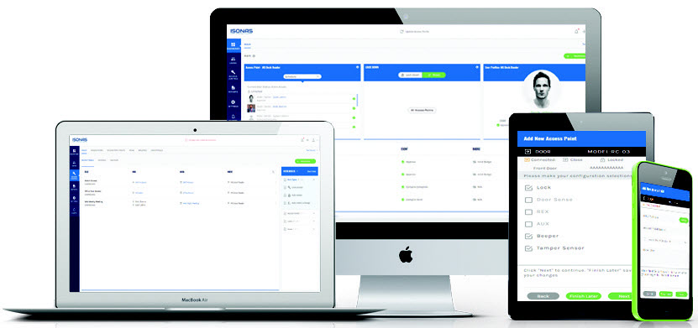
Core Components
Unique, patented hardware
Leading SaaS and on premise access control software
Allows access control to utilize on-site network infrastructure
More scalable
More flexible
30-40% less expensive
Assembled in the USA
Pure Access Cloud
Pure Access Manager
Full featured access control
Modern, intuitive user interface
Device agnostic (Apple and Android)
Easy to operate for non-security personnel

Slide 11
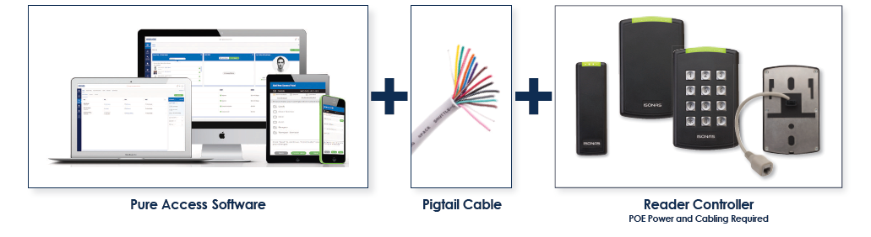
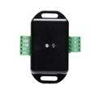

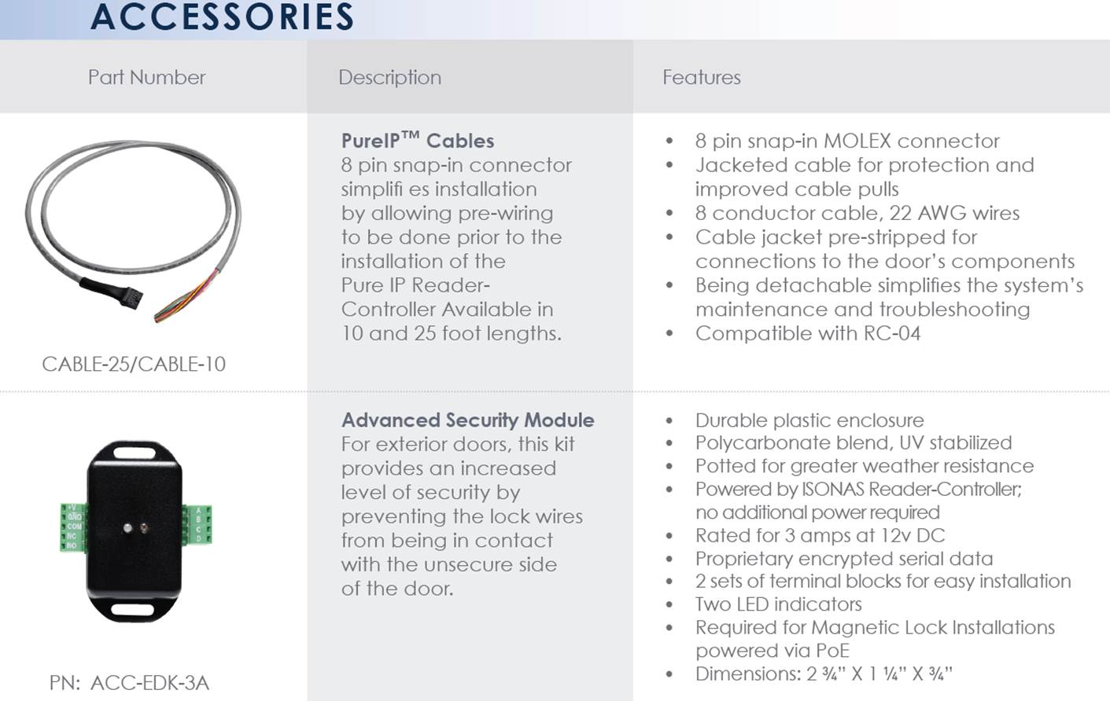
ISONAS System
ISONAS Required Equipment
Advanced Security Module
Accessories
Added level of security at the door
Provides a form C Relay (when you need more than 600ma, 12VDC or 24VDC Power)

Slide 12
ISONAS System MSRP Pricing Example
ISONAS Required Equipment
Advanced Security Module
1-5 Door License $ 400.00
10 ft Pigtail Cable $ 43.77
Reader Controller $ 924.99
Adv Security Module $ 74.99
Total $1,443.75

Slide 13
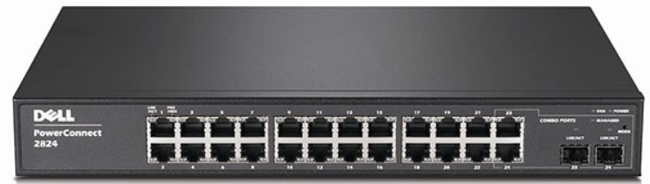
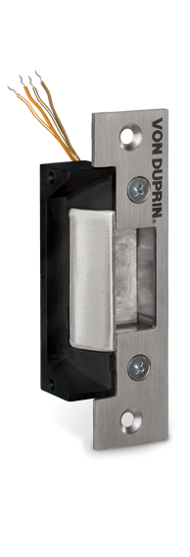
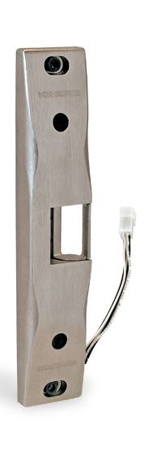
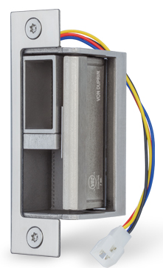
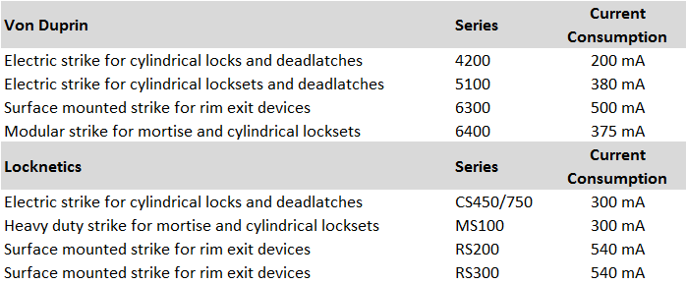
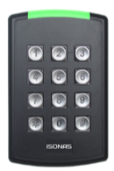
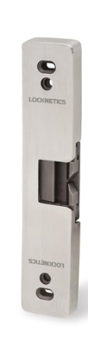
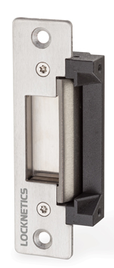

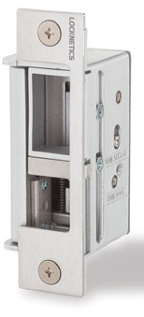
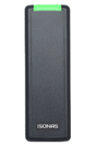
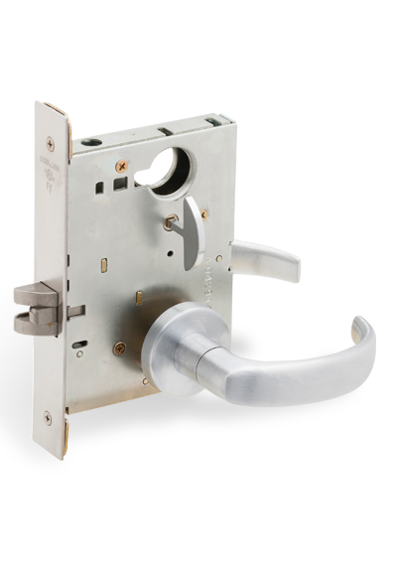
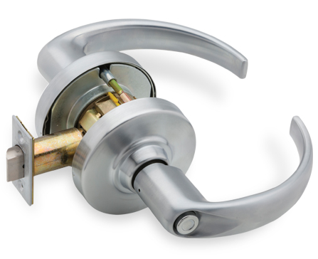

What Allegion Hardware works with ISONAS?
12VDC solid state relay and 600ma power budget from 802.3af PoE Switch
(NO Independent Power Supply Required)
Electric Strikes
Electric Levers/Mortise Locks

Slide 14
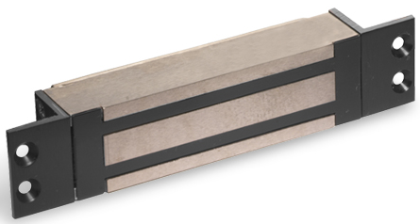
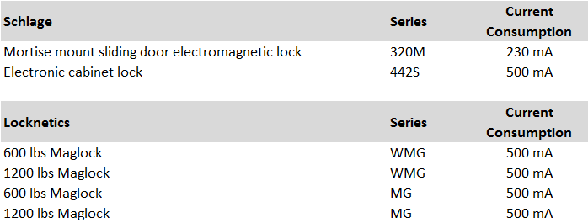
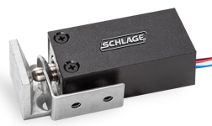
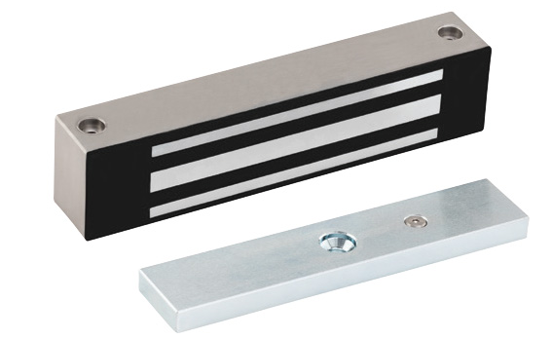
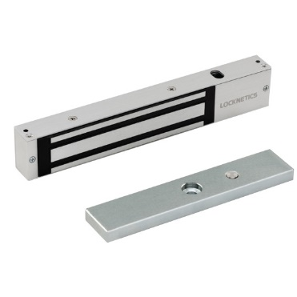
What Allegion Hardware works with ISONAS?
ISONAS Allegion Lock Options
A PoE Splitter can be used to power the maglock and the reader-controller
(Must use separate power supply for UL-294 listed installations)

Slide 15
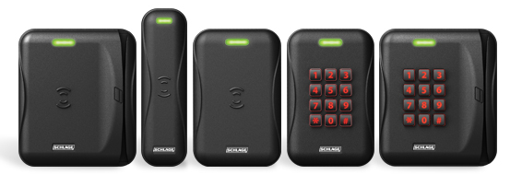
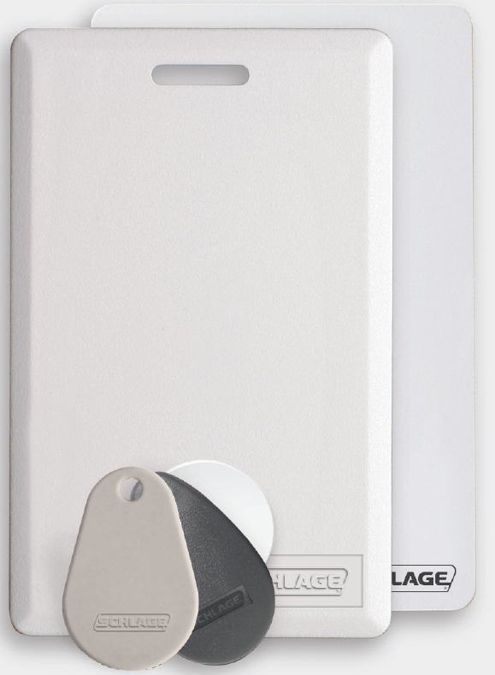
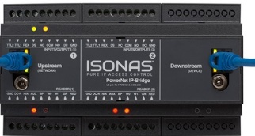
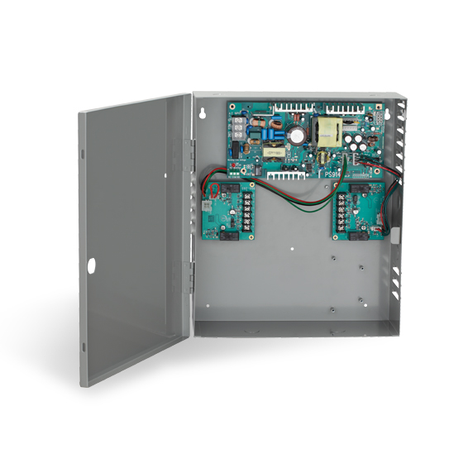
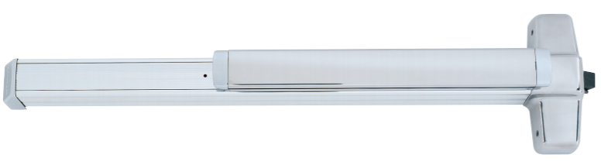
What Allegion Hardware works with ISONAS?
ISONAS Allegion Lock Options
ISONAS IP Bridge
Schlage Wiegand Readers
*Must use 125kHz Prox for compatibility with
ISONAS Reader Controller
PS914/PS902
EL & QEL

Slide 16



ISONAS
Application
Examples

Slide 17
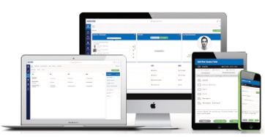
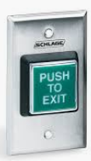
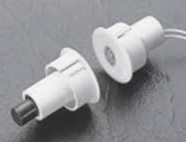
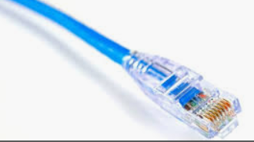
4 Door Warehouse
ISONAS System Components
Location contains:
Front Door
Back Door
2 Side Doors
Item | MSRP | Qty | Total
RC-04-PRX-W | $924.99 | 4 | $3,699.96
CABLE-RC04-10 | $43.75 | 4 | $175.00
ACC-EDK-3A | $74.99 | 4 | $299.96
PA-C-1-5 | $400.00 | 1 | $400.00
TOTAL |  |  | $4,574.92
Physical Cred | KF-3-20 | 1 | $127.50
BLE Mobile Cred | FREE |  | FREE
Per Door |  |  | $1175.61
Other Physical Security System Components:
Electric Locking Device
Door Position Switch (DPS)
REX Device (Motion Detection or Push Button)
Network System Components:
POE Switch with an Internet Service
Category Cable

Slide 18
Franchise Locations
Geographical Dispersion
Hierarchical Administrative Views
Store A
Supervisor A
Supervisor A can only see his/her store in the software as an AREA.
Pure Access
Franchise Owner
Supervisor B
Franchise Owner has full administrative rights and can see both stores
Supervisor A can only see his/her store in the software as an AREA.
Store B
The Physical Access Control Components remain the same but simply increase in quantitiy based on the number of doors/locations

Slide 19
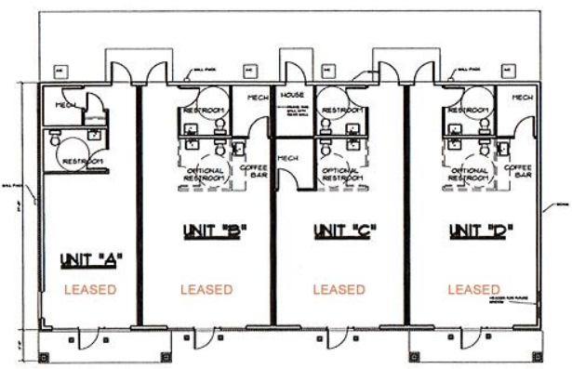
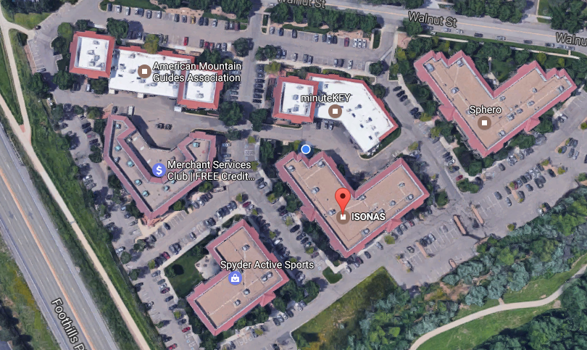
Industrial Park Suites
Ideal application for ISONAS RMR License
Manage up to 25 tenants/300 Doors on a single license
Suite A, B, C, D, E,…Z Location contains:
Front Door
Back Door
The Dealer uses their RMR license to sell seat licenses to up to 25 users. The dealer has “Master” Administrative rights to assist/manage all locations.
Each user has independent authority for only their location.

Slide 20

Corp Office w Property Management
Location contains:
Exterior Door (Property Manage w own Access)
Suites w ISONAS access control
Same credentials?
Suite
  Front, Back, Delivery Doors
  Auto Openers
  BLE
  Physical
  Parking
  VMS Integration

Slide 21
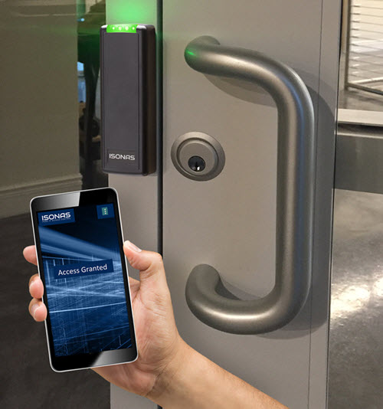
ISONAS
Hardware

Slide 22
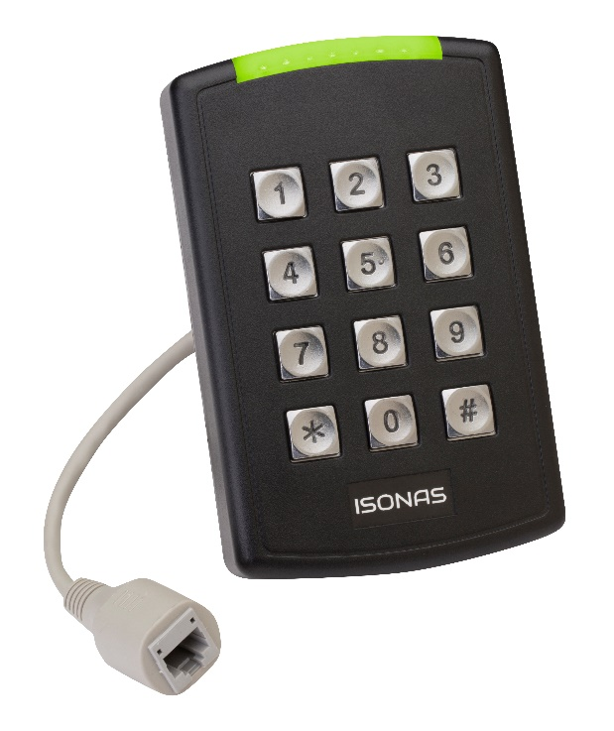



ISONAS Pure IP Reader-Controllers
ISONAS has installed more than 50,000 reader-controllers for organizations worldwide. Small and Medium size business are a core growth engine with market installations including education and healthcare institutions, to state and local governments, to Fortune 500 companies.
Pure IP Reader- Controller (RC-04)
The ISONAS Pure IP family takes advantage of patented technology and remains an all in one intelligent device eliminating the need for a separate panel. Features include:
Multiple form factors
Multiple RFID formats (125 kHz and 13.56 MHz)
Bluetooth enabled to allow use of smart phone as a credential
Local mode decision making allowing functionality without network connectivity
Advanced tamper detection via accelerometer
Metal back plate for ease of installation
Indoor and Outdoor rated
UL294 V6 Certified
Made in the USA
Field programmable IP
USA & EU mounting options
Encryption Key management

Slide 23



ISONAS Legacy Takeover Solution
Customers that have access control want more, however they are trapped into proprietary systems.
The IP Bridge frees the customer to move to an open architecture IP platform
PowerNet IP-Bridge
Pure IP Wiegand Readers (R-1)
Replaces existing panels and eliminates the need to rip and replace existing hardware to upgrade system. Use existing readers.
Seamlessly allows migration to a Pure IP Access Control solution by bridging Wiegand systems with Pure IP Systems via the IT Network
Local decision making, centralized programming
Utilizes existing power supplies or use PoE (802.3af) or PoE+ (802.3at)
Up to 32 IP-Bridges can be placed in series (96 doors) using a single switch port
2 or 3 door options, Wiegand Inputs, DIN-Rail mountable, Compact Size (6” wide)
All Wiegand Readers available in Multi-Card technology, providing flexibility in credential model choice
Bluetooth Low Energy (BLE) enabled for smart phone

Slide 24

ISONAS Pure Mobile Credentials
Proprietary mobile software integrates into ISONAS Pure IP hardware, significantly reducing cost and complexity of legacy access control key management.
Mobile Credentials
ISONAS Pure Mobile has the following capabilities:
Quick Enrollment and Management Settings
IOS and Android Compatibility
Secure encrypted communication with unique session keys
Non-transferrable credentials
Market is shifting towards innovative technologies that reduce scale costs and provide better security management. Pure IP hardware eliminates the need for a physical card, allowing organizations to efficiently manage an unlimited number of credentials and manage access control in real-time.

Slide 25





ISONAS Topology (Reader-Controller)
Geographically Dispersed
Door Open Sensor
Door Lock
Request For Exit

Slide 26
ISONAS Topology (Bridge & Wiegand Reader)
Geographically Dispersed
Junction
Box
Door Open Sensor
Request For Exit
PS and Battery
R-1 Reader
Door Lock

Slide 27

Pure Access
Software
Need a Software picture

Slide 28
Forefront of Software Innovation
ISONAS access control software products include a fully hosted platform, Pure Access Cloud, and an on premise option, Pure Access Manager.
ISONAS Pure Access Software
The Complete Access Control platform allows full installation, administration and management of ISONAS patented Pure IP Access Control Hardware.
Modern user interface establishes a new standard for ease of use in managing an unlimited number of access points across any geography through mobile device, tablet or modern browser.
New features and functionality to Access Control that fully leverage the power of ISONAS Pure IP hardware.
Access Point Configuration Wizard
Features
Setup and configuration can be done easily and quickly by a single technician, reducing installation time and cost.
Step by step, access point check out process allows testing of the IP configuration and connectivity, lock wiring, encryption and all unique door configurations from a mobile device or tablet.
Cloud or Manager (on-premise)
Simple User interface and intuitive work flow
Real time monitoring, unlimited dashboards and alerts
Full reporting suite
Active Directory integration
Web API
Badge printing integration
Responsive design for mobile devices
Master integrator licenses for RMR business model
Custom rules engine
Floor plan views
Partitioned tenants with defined areas
Predefined and customizable user roles and permissions
Integrated with leading Video Management Software providers
Private Cloud structure available to large customers

Slide 29

ISONAS Pure Access Cloud
ISONAS Pure Access is architected for the cloud, assuring best-in-class features and functionality, infinite scalability, and bullet proof security with real time threat response and security updating.
ISONAS Cloud Software
On Demand
Self Service
Broad Network Access (mobile)
Resource Sharing
Rapid Elasticity
Measured Service - Pay per use
99.999% up time
Amazon Web Services – RDS infrastructure
Barracuda / Elastic Load balancing
Nagios 24/7 monitoring
Java and .NET architecture
Encryption systemwide
Postgres Database with Tenancy
Caching, Read replication and Sharding by Tenant
ISONAS obsoletes traditional on premise solutions and moves management to the cloud.
Notes:
Sharding is a type of database partitioning that separates very large databases the into smaller, faster, more easily managed parts called data shards.

Slide 30

Providing Best-in-Class Cyber Security
Cybersecurity is better addressed by cloud based solutions and ISONAS is at the leading edge of securing the cloud.
Amazon Web Services
ISONAS has invested heavily in a robust Amazon Web Services (AWS) cyber security platform that incorporates the highest levels of security:
  Overall structure
  Perimeter security
  Internal security
  Encryption & data protection
  Testing & Monitoring
  Redundancy and Load Balancing
  Support Philosophy
A 2017 IPVM survey found cloud based services and cyber security as the two top trends of the year. ISONAS is perfectly positioned.
Why the Cloud provides better Cyber Security than On Prem Solutions
Cloud based security services have fewer cyber security vulnerabilities than traditional on premise solutions:
On premise “enterprise” systems suffer from a host of vulnerabilities including port forwarding, firewall complexity, operating system patches, operating system passwords, network topology, connection encryption, video encryption, mobile connections and physical access to the physical system.
In contrast, it is much easier for an end user to evaluate the cloud provider it is working with and significantly reduce or eliminate cyber security risk.
NIST has established its “True Cloud: NIST 5-3-2 Framework”
  5 key characteristics of a true cloud
  3 implementation methods
  2 deployments models
ISONAS meets or exceeds the NIST standards in all respects.
¹ “Cyber Security for the New Connected Physical Security Worlds: A Cyber Security Veteran’s Perspective”, Cloud+ Security Conference, Speaker: Dean Drako, November 28-29, 2017.

Slide 31

ISONAS Pure Access Manager
ISONAS offers an on premise version of Pure Access that addresses the segment of the market that, while clamoring for modern architecture, is still unable or unwilling to embrace cloud deployment.
Pure Access Manager – Customer Profile
Pure Access Manager – Features
Government installations precluded from Cloud applications
Larger installations with perceived strong IT support staff and infrastructure
Leadership unwilling to embrace the strength of Cloud security
Sites with no or limited internet connectivity
Shared code base with Pure Access Cloud. Architected as a cloud solution with a single instance installation.
Perpetual licensing
20% Software Upgrade and Support Program
Auto discovery of devices across sub-nets
Features and bug fixes deployed to Pure Access Cloud are available to Pure Access Manager within 7 days
Pre-configured with data backup and restore facilities
No additional licensing required other than Pure Access Manager
Best in class, open source programs packaged with Pure Access Manager installer include Apache Tomcat, PostgreSQL and Java
Supports Windows platforms

Slide 32
$
Recurring Monthly Revenue

Slide 33
Recurring Monthly Revenue RMR
Hosted Access Control Service-Why?
Understanding “why” this service model makes sense and how it positions within a dealer’s access control portfolio is essential when considering this service model. The cost of installing the first door as well as the requirement for an end user to identify and assign responsibility to a person within their organization to learn how to use access control software is frequently an inhibitor for end user customers considering electronic access control in the 1-8+ door segment.
This service model addresses these electronic access control impediments by:
  Eliminating the need for head end infrastructure-PC/server, access control software, software support agreements and IT support services at the customer location.
  Reducing the cost of the installed door with the ISONAS IP/POE Reader-Controllers
  Offering the End User options for access control management.
The ISONAS solution enables dealers to develop and build RMR with two service offerings:
Hosted/Managed Access Control Service
  This service is targeted to end users with limited resources and/or no interest in learning how to use access control software and managing their access control system.
  The dealer will administer all programming, cardholder DB management and report services for their customers.
Hosted Access Control Service
  This service is targeted to end users who prefer to manage their access control DB.
  After initial system programming and training the End User is responsible for day to day management including programming, cardholder modifications and report generation.
  The end user will not have access to system programming capabilities and will rely on the dealer to provide this service.

Slide 34
ISONAS RMR License Benefit
Pure Access Cloud, Integrator RMR License with Customer Partitioning (25 Tenants/300 Doors)
Allows an Integrator to manage 25 individual tenants with up to 300 doors total.
Standard License Example
RMR License Example
25 Customers each with 12 Doors (300 Doors)
Software License for 6-20 Doors $1000 MSRP
$1,000 x 25 = $25,000
25 Customers each with 12 Doors (300 Doors)
Software RMR License with Customer Partitioning (25 Tenants/300 Doors)
$5,000 MSRP x 1 = $5,000
$20,000 Savings at MSRP

Slide 35

Training

Slide 36

Training and Certification
Training Resources
Training Overview
ISONAS employs a full time trainer whose charge is to create content, enact best practices from the product group, and work with the sales team to attract and enroll prospective integrators. Integrator training is delivered in two methods; an online university and in person classroom sessions.
Online https://www.isonas.com/online-training/isonas-certified-partner-program/
Unlimited number of students enrolled at one time
Content delivered via a personalized online learning platform, allowing students to proceed at their own pace
At the end of each module, students are evaluated and permitted to continue only if mastery is exhibited
Conclusion is an evaluation of an uploaded report of their access control environment
Need to order a demo kit to complete training ($345 Direct from ISONAS)
In Person
Classes of 8-16 people
Commonly held at RSO, distribution branches or at integrators
Content delivered with hands on labs that create ISONAS HW and SW competency
Conclusion is an evaluation of installation and wiring of HW and successful creation of SW environment
$750 cost per individual
Certification is commonly completed in 8 hours
Notes:
We will take a support call from a NON-Certified Integrator via our One Time Support call of $249.00.

Slide 37

Certified Integrator Demo Kit

Slide 38

Easy to Design, Install, and Use

Slide 39

Easy to Design, Install, and Use

Slide 40

Appendix

Slide 41














Technology Partners
ISONAS solutions embrace open architecture, promoting integration with ancillary third party hardware and software solutions.
Software Integrated to ISONAS Hardware Products
ISONAS provides customers a choice in their access control hardware and is committed to expanding access to markets through 3rd party enterprise class software solutions.
  Customers can select ISONAS hardware in conjunction with or as a replacement to traditional access control hardware with a number of different software platforms. Choice and flexibility drives adoption and purchase.
  3rd party software manufacturers are engaged in many OEM branded or ISONAS branded strategies.
Video Management Integration with ISONAS Software and Hardware
ISONAS integrates into VMS software rather than vice versa, to enhance functionality and create additional channels to markets. ISONAS is a finalist for the Milestone Partner of the Year award.

Slide 42



ISONAS Badge Printing Solutions
ISONAS offers a comprehensive badge printing software solution from Entrust Datacard
Easily create custom cards with the drag-and-drop designer
Supports multiple designs including data-driven images
Add QR codes, mag-stripe, and even smart card encoding
    Drag-and-Drop Designer with 600 dpi printing capability
    Allows you to easily create multiple designs and add security and encoding elements to each design for ultimate card flexibility, enhanced branding, and personalization

Slide 43








ISONAS Solutions Expand Applications
ISONAS solutions can be used for applications that traditional access control systems can not, increasing the customer value proposition and total available market.
Ambulances
Fork lifts
Armored Vehicles
Computer Server Racks
Controlling access to prescription drugs
Controlling access to meet OSHA requirements
Restricting and monitoring access to high valued assets
Eliminating the need for wiring and external power
K-12 Education
Wireless Apps
Public Transportation
Medical
Monitoring and controlling access to improve safety and security
Access for fleet vehicles and tracking usage with network activity
Restricting access to areas for authorized personnel only
Monitoring and tracking medical cabinet usage

Slide 44
ISONAS REGIONAL TERRITORIES – May 1, 2019
Kyle Wiberg
Kyle Wiberg
Ken Minard
Paul Cernak
West Regional Mgr.
Nor Cal
So Cal
Northwest
Mountain Regional Mgr.
Mountain States
North Central
Southwest
Great Lakes Regional Mgr.
Chicago
Michigan
Midwest
Northeast Regional Mgr.
New England
New York
Mid Atlantic
Kimberly Hanold
Southeast Regional Mgr.
Carolinas
South
Florida
Clay Sharp
Central Regional Mgr.
Central
Texas

Slide 45
The ISONAS Team

Slide 46






ISONAS Market Positioning
Small Business
Medium Business
Mid-Market
Enterprise
Multi Family
Prox,
ISONAS Smart,
ISONAS Mobile
Sys. Comp + Elec Mechanical
The software features are ideal for “Medium Complexity”
The ISONAS solution is not limited by #Doors, #Users, #Locations.

Slide 47
RSO Training Information
Positioning
Where Does Isonas Fit?
Low to Medium Complexity Access Control Systems
Large Reader-Controller Deployments – many locations, low reader count per location
Cloud Based Solutions
Any system with a need for 1-20 Reader-Controllers (consistent w “Medium Complexity” software features)
Integrators/Locksmiths who understand and want to grow Recurring Monthly Revenue with Access Control
Where Are We Being Successful?
K-12 Market – Non-Specified projects – primarily design/build and after-market
Property Management Companies
Smaller, Higher Education (i.e. community colleges, D-III schools)
Managed Service Providers (MSPs)
Takeover Opportunities Where EU needs a single system for multiple locations
ANYTIME an IT Person is Involved in the Opportunity
Any Customer Looking to Move to Cloud
Any opportunity to work on a Design/Build Opportunity

Slide 48
RSO Training Information
Positioning
Difference Between ISONAS and Legacy Panel Solutions
True IP Based Solution
No Panels, No Power Supplies, No Conduit, No 110VAC Required
ISONAS Does Not Require a Licensed Electrical Contractor to Provide Power
Sold Exclusively Through Distribution – ADI, Anixter, CSC, Security Lock Distributors, Accu-Tech and a few Regional Distributors
ISONAS is one of the simplest access system to install
True, Hosted, Cloud-Based Solution
Third Party Integrations – Open Options, Milestone, OnSSI, DataCard, Genetec (Coming soon).
Limitations to ISONAS
No Input Monitor Capability (i.e. man-doors, overhead doors)
Large, Complex Installations with Multiple Integration Requirements
Smaller Access Opportunities that Will Not Consider a Cloud Solution
Today – No Schlage Wireless Elock integration (expected in 2020)

Slide 49

HARDWARE MSRP – Key SKUs
ISONAS PRICE LIST MARCH 2019

Slide 50

Software MSRP – Key SKUs
Multi-Year software licenses are available
ISONAS PRICE LIST MARCH 2019

